Slide 1
UNIT OPERATIONS AND FLUID MECHANICS
UNIT-3 Part -2

Slide 2
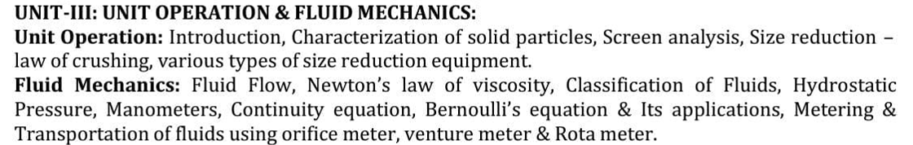
Notes:
https://www.slideshare.net/slideshow/size-reduction-237810791/237810791

Slide 3
FLUID MECHANICS

Slide 4
Fluid mechanics is an important area of engineering science.
The nature of flow in pipes, pumps and reactors depends on
The power input to the system and
The physical characteristics of the fluid.
In fermenters, fluid properties affect process energy requirements and the effectiveness of mixing, which can have a dramatic influence on productivity and the success of equipment scale-up.
Transport of heat and mass is often coupled with fluid flow.
To understand the mechanisms of these important transport processes, we must first examine the behavior of fluid near surfaces and interfaces.
Fluids in bioprocessing often contain suspended solids, consist of more than one phase, and have non-Newtonian properties.
All of these features complicate analysis of flow behaviour and present many challenges in bioprocess design.

Slide 5
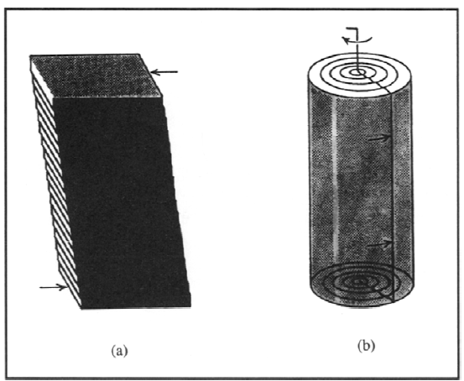
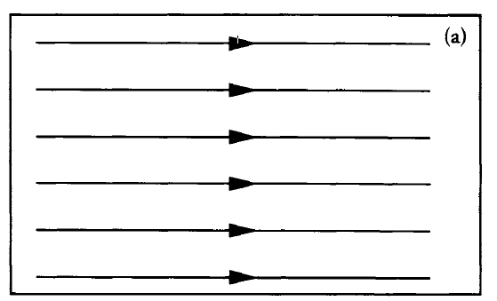
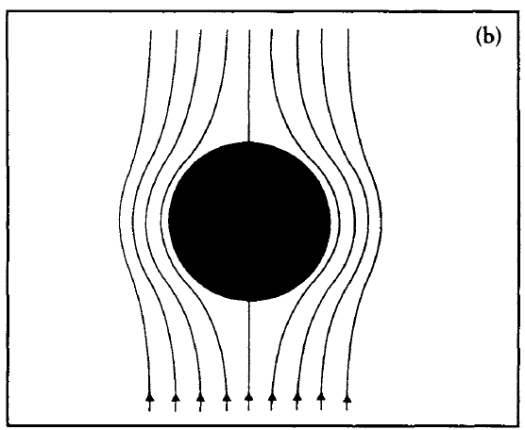
Figure 7.2 Streamlines for (a) constant fluid velocity; (b)steady flow over a submerged object.
the effect of shear force in planar and rotational systems is illustrated in Figure 7.1.
Shear forces in these examples cause deformation,
which is a change in the relative positions of parts of a body.
A shear force must be applied to produce fluid flow.

Slide 6
There are two types of stress that a structure can experience:
1. Normal Stress and 2. Shear Stress.
When a force acts perpendicular (or "normal") to the surface of an object, it exerts a normal stress.
When a force (shear force) acts parallel to the surface of an object, it exerts a shear stress.

Slide 7
Classification of Fluids
A fluid is a substance which undergoes continuous deformation when subjected to a shearing force. A simple shearing force is one which causes thin parallel plates to slide over each other, as in a pack of cards.
Shear can also occur in other geometries;
Fluids can be either gases or liquids.
Two physical properties, viscosity and density, are used to classify fluids.
If the density of a fluid changes with pressure, the fluid is compressible.
Gases are generally classed as compressible fluids. ρ = fun ( pressure)
The density of liquids is practically independent of pressure;
liquids are incompressible fluids. ρ = fun ( pressure)
Sometimes the distinction between compressible and incompressible fluid is not well defined; for example, a gas may be treated as incompressible if variations of pressure and temperature are small.

Slide 8
Fluids are also classified on the basis of viscosity
Viscosity is the property of fluids responsible for internal friction during flow.
Friction is the force that resists movement when two surfaces touch
An ideal or perfect fluid is a hypothetical liquid or gas.
which is incompressible and has zero viscosity. The term inviscid applies to fluids with zero viscosity.
All real fluids have finite viscosity and are therefore called viscidor viscous fluids.
Drag force and viscosity are related but distinct concepts. Viscosity is an intrinsic property of a fluid that describes its resistance to flow, while drag force is a force that opposes the motion of an object through a fluid.
Viscosity is the cause, drag force is the effect.

Slide 9
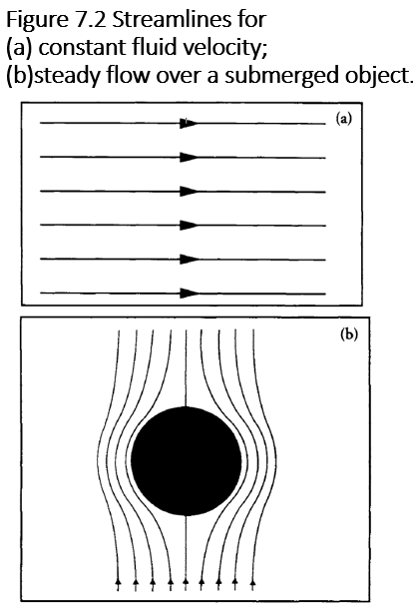
Fluids in Motion
Bioprocesses involve fluids in motion in vessels and pipes.
General characteristics of fluid flow are Streamlines
When a fluid flows through a pipe or over a solid object, the velocity of the fluid varies depending on position. One way of representing variation in velocity is streamlines, which follow the flow path. Constant velocity is shown by equidistant spacing of parallel streamlines as shown in Figure 7.2(a). The velocity profile for slow-moving fluid flowing over a submerged object is shown in Figure 7.2(b); reduced spacing between the streamlines indicates that the velocity at the top and bottom of the object is greater than at the front and back.
Streamlines show only the net effect of fluid motion; although streamlines suggest smooth continuous flow, fluid
molecules may actually be moving in an erratic fashion. The slower the flow the more closely the streamlines represent actual motion. Slow fluid flow is therefore called streamline or laminar flow.
In fast motion, fluid particles frequently cross and recross the streamlines. This motion is called turbulent flow and is characterised by formation of eddies.

Slide 10


Reynolds Number
Transition from laminar to turbulent flow depends not only on the velocity of the fluid, but also on its viscosity and density and the geometry of the flow conduit.
A parameter used to characterise fluid flow is the Reynolds number. For full flow in pipes with circular cross-section, Reynolds number Re is defined as:
where D is pipe diameter, u is average linear velocity of the fluid, ρ is fluid density, and ) µ is fluid viscosity.
For stirred vessels there is another definition of Reynolds number:
where Re_{i} is the impeller Reynolds number, N_{i} is stirrer speed,
D_{i} is impeller diameter (stirrer ), ρ is fluid density and µ is fluid viscosity.

Slide 11
The Reynolds number is a dimensionless variable; the units and dimensions of the parameters in Eqs (7.1) and (7.2) cancel completely.
Reynolds number is named after Osborne Reynolds, who published in 1883 a classical series of papers on the nature of flow in pipes. One of the most significant outcomes of Reynolds' experiments is that there is a critical Reynolds number which marks the upper boundary for laminar flow in pipes.
In smooth pipes,
Flow is laminar flow at Re < 2100 Under normal conditions,
flow is turbulent at Re > 4000.
2100 > Re < 4000 is the transition region where flow may be either laminar or turbulent depending on conditions at the entrance of the pipe and other variables.
Flow in stirred tanks may also be laminar or turbulent as a function of the impeller Reynolds number.
The value of Re_{i} marking the transition between these flow regimes depends on the geometry of the impeller and tank.
for several commonly-used mixing systems, laminar flow is found at Re_{i} ~< 10.

Slide 12
Different flows
Potential flow / Irrotational flow /Ideal flow : (µ =0)
Rotaional / real flow : fluid particles rotate about their own axis as they move through the flow.
Compressible : ρ = fun( pressure) ex : gases inviscid (µ =0)
In Compressible : ρ = fun ( pressure) ex: liquids viscidor (µ =0)
Laminar flow : Re < 2100
Turbulent flow : Re > 4000
Transition region :2000 < Re > 4000 either laminar or turbulent depend up on the fluid entering the plate. Critical Reynolds number.
Uniform : Velocity = constant
Non Uniform flow : Velocity = constant
Steady flow : flow conditions like velocity, pressure, density etc doesn’t change with time
UnSteady flow : flow conditions like velocity, pressure, density etc change with time

Slide 13
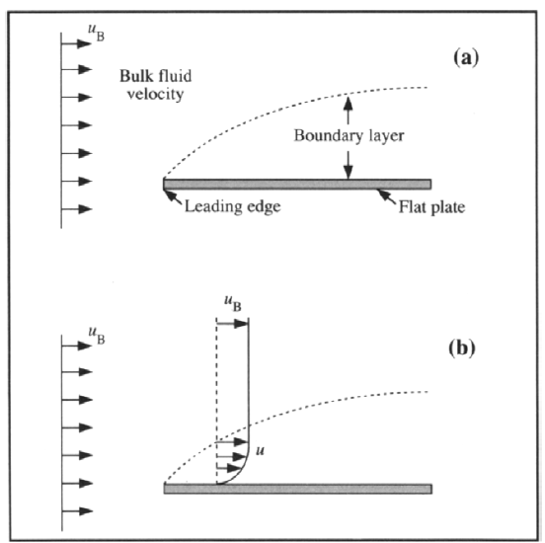
Hydrodynamic Boundary Layers
In most practical applications, fluid flow occurs in the presence of a stationary solid surface, such as the walls of a pipe or tank.
That part of the fluid where flow is affected by the solid is called the boundary layer.
As an example, consider flow of fluid parallel to the flat plate shown in Fig.
Contact between the moving fluid and the plate causes formation of a boundary layer beginning at the leading edge and developing on both top and bottom of the plate.
Figure shows only the upper stream; fluid motion below the plate will be a mirror image of that above.
in Fig (a),
Arrows →the bulk fluid velocity in front of the plate is uniform with magnitude u_{B} .
Broken line →The extent of the boundary layer.
Above the boundary layer, fluid motion is the same as if the plate were not there. The boundary layer grows in thickness from the leading edge until it fully developed
Final thickness of the boundary layer depends on the Reynolds number for bulk flow.

Slide 14
When fluid flows over a stationary object, a thin film of fluid in contact with the surface adheres to it to prevent slippage over the surface. Fluid velocity at the surface of the plate is therefore zero.
When part of a flowing fluid has been brought to rest, the flow of adjacent fluid layers is slowed down by the action of viscous drag. (fluid resistance to against moving object )
Fluid's resistance: When an object moves through a fluid (like air or water), the fluid molecules collide with the surface of the object, resisting object motion. This resistance is what we call drag.
u → Velocity of fluid within the boundary layer; u is zero at the surface of the plate.
Viscous drag forces are transmitted upwards through the fluid from the stationary layer at the surface. The fluid layer just above the surface moves at a slow but finite velocity; layers further above move at increasing velocity as the drag forces associated with the stationary layer decrease. At the edge of the boundary layer, fluid is unaffected by the presence of the plate and the velocity is close to that of the bulk flow, u_{B}.
The line connecting the heads of the velocity arrows shows the velocity profile in the fluid.
A Velocity gradient, i.e. a change in velocity with distance from the plate, is thus established in a direction perpendicular to the direction of flow.
The velocity gradient forms as the drag force resulting from retardation of fluid at the surface is transmitted through the fluid.
Formation of boundary layers is important not only in determining characteristics of fluid flow, but also for transfer of heat and mass between phases.

Slide 15
Difference between viscosity, Drag, friction.
Concept | What It Describes | Medium | Opposes Motion? | Depends on Velocity? | Example Scenario
Viscosity | Internal resistance within a fluid | Fluids | ✅ Yes (internally) | ✅ Yes (in flow equations) | Honey flowing slowly from a spoon
Drag | Resistance in fluid on a moving object | Fluids (air, water) | ✅ Yes | ✅ Yes (often ∝ v²) | Air resistance on a falling parachute
Friction | Resistance between solid surfaces | Solids | ✅ Yes | ❌ Not directly | Rubbing hands together
Notes:
https://www.linkedin.com/pulse/components-centrifugal-pump-innovative-engineers-network-6bdfc/

Slide 17
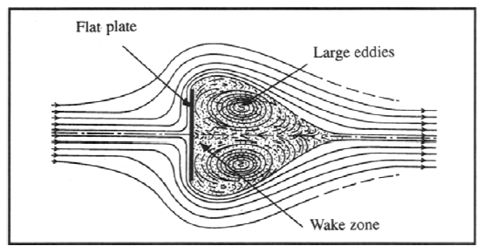
Boundary-Layer Separation
What happens when contact is broken between a fluid and a solid immersed in the flow path?
Consider a flat plate aligned perpendicular to the direction of fluid flow
Fluid impinges on the surface of the plate, and forms a boundary layer as it flows either up or down the object.
When fluid reaches the top or bottom of the plate its momentum prevents it from making the sharp turn around the edge.
As a result, fluid separates from the plate and proceeds outwards into the bulk fluid. Directly behind the plate is a zone of highly decelerating fluid in which large eddies or vortices are formed. This zone is called the wake.
Eddies in the wake are kept in rotational motion
by the force of bordering currents.

Slide 18
When it occurs
Boundary-layer separation
occurs whenever an abrupt change in either magnitude or direction of fluid velocity is too great for the fluid to keep to a solid surface.
It occurs in sudden contractions, expansions or bends in the flow channel, or when an object is placed across the flow path.
Formation of wakes should be minimized if large pressure losses in the fluid are to be avoided.
When energy is associated with the wake; this energy is taken from the bulk flow. ( part of energy will be associated with the wake, then obviously energy for flow of fluid becomes less)
however, for some purposes such as promotion of mixing and heat transfer, boundary-layer separation may be desirable.

Slide 19
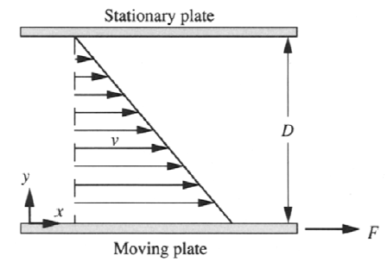
Viscosity
Viscosity is the most important property affecting flow behavior of a fluid;
viscosity is related to the fluid's resistance to motion.
Viscosity has a marked effect on pumping, mixing, mass transfer, heat transfer and aeration of fluids; these in turn exert a major influence on bioprocess design and economics.
Viscosity of fermentation fluids is affected by the presence of cells, substrates, products and air.
Viscosity is an important aspect of rheology, the science of deformation and flow.
Viscosity is determined by relating the velocity gradient in fluids to the shear force causing flow to occur.
This relationship can be explained by considering the
development of laminar flow between parallel plates.
The plates are a relatively short distance apart and,
and the fluid between them is stationary.
The lower plate is then moved steadily to the right with shear force F,
while the upper plate remains fixed.
A thin film of fluid adheres to the surface of each plate.
Therefore as the lower plate moves, fluid moves with it, while
at the surface of the stationary plate the fluid velocity is zero.
Due to viscous drag, fluid just above the moving plate is set into motion,
but with reduced speed
Velocity profile for Couette flow between
parallel plates.

Slide 20



Couette flow
Couette flow refers to the flow of a fluid between two surfaces that are moving at different velocities, such as two concentric cylinders or two parallel planes.
When steady Couette flow is attained in simple fluids
velocity profile( the slope of the line connecting all the velocity arrows) is constant and proportional to the shear force F responsible for motion of the plate.
The slope of the line connecting the velocity arrows is the velocity gradient, dV/dy.
When the magnitude of the velocity gradient is directly proportional to F :
If we define " Ƭ” as the shear stress, equal to the shear force per unit area of plate:
This proportionality is represented by the equation
eq is called Newton's law of viscosity
where µ is the proportionality constant.
“ - ve ” → the velocity gradient is always negative
-dV/dy is called the shear rate.

Slide 21
Viscosity is sometimes called dynamic viscosity. It measures how much force is needed to make one layer of fluid slide over another.
As "Ƭ” has dimensions L⁻¹MT⁻² and
has dimensions T ⁻¹ ; “µ” must therefore have dimensions L⁻¹MT⁻¹.
The SI unit of viscosity is the Pascal second (Pa s)= 1 N s m ⁻² or 1 kg m⁻¹ S⁻¹
A modified form of viscosity is the kinematic viscosity, defined as µ/ ρ
where p is fluid density;
kinematic viscosity is usually given the symbol v. tells how easily a fluid flows under gravity.
Units 1 cP or 10⁻³ Pa s.

Slide 22
Viscosity Comparison Table
Feature | Dynamic Viscosity (μ) | Kinematic Viscosity (ν)
Definition | Resistance due to internal friction | Ratio of dynamic viscosity to fluid density
What it describes | Force needed to move one fluid layer over another | Ease of flow under gravity
Depends on | Shear stress & shear rate | Dynamic viscosity & density
Units | Pa·s or Ns/m² | m²/s
Symbol | μ | ν
Force required? | Yes | No
Also called | Absolute viscosity | Momentum diffusivity
Example fluid | Honey (high μ — flows slowly) | Water (low ν — flows easily)

Slide 23

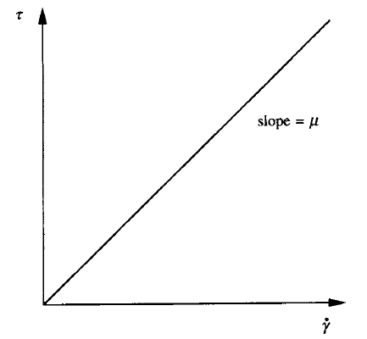
Fluids can be classified further as
Newtonian or non-Newtonian.
Fluids which obey Eq. with constant μ are known a Newtonian fluids.
The flow curve or rheogram for a Newtonian fluid
the slope of a plot of “Ƭ" versus is constant and equal to “µ”.
The viscosity of Newtonian fluids remains constant despite
changes in shear stress (force applied) or shear rate (velocity gradient).
This does not imply that the viscosity is invariant;
viscosity depends on many parameters
such as temperature, pressure and fluid composition.
However, under a given set of these conditions, viscosity of Newtonian fluids is independent of shear stress and shear rate.
On the other hand, the ratio between shear stress and shear rate is not constant for non-Newtonian fluids, but depends on the shear force exerted on the fluid. Velocity profile during Couette flow is not as simple as that shown in Figure

Slide 24
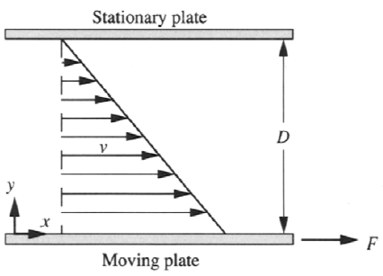

Momentum transfer
Viscous drag forces responsible for the velocity gradient in Fig are the instrument
of momentum transfer in fluids.
At y = 0 the fluid acquires momentum in the x-direction due to motion of the
lower plate. This fluid imparts some of its momentum to the adjacent layer of
fluid above the plate, causing it also to move in the x-direction.
Momentum in x-direction is transmitted through the fluid in y direction.
To interpret this equation in terms of momentum transfer,
Shear stress “ Ƭ ” is considered as the flux of x-momentum in the y direction.
The validity of this definition can be verified by checking the dimensions of momentum flux and shear stress.
Momentum is given by the expression “Mv” where M is mass and v is velocity; dimensions MLT ⁻¹.
Flux means rate per unit area; therefore momentum flux has dimensions ML ⁻¹T ⁻² = dimensions of Ƭ.
So with representing momentum flux, according to Eq
flux of momentum is directly proportional to the velocity gradient dV/dy.
The negative sign in Eq means that momentum is transferred from regions of high velocity to regions of low velocity, i.e. in a direction opposite to the direction of increasing velocity.
The magnitude of the velocity gradient dVldy determines the magnitude of the momentum flux; dV/dy thus acts as the 'driving force' for momentum transfer.

Slide 25
Non Newtonian fluids
Most slurries, suspensions and dispersions are non-Newtonian, as are homogeneous solutions of long-chain polymers and other large molecules.
Many fermentation processes involve materials which exhibit non-Newtonian behaviour, such as starches, extracellular polysaccharides, and culture broths containing cell suspensions or pellets.
Classification of non-Newtonian fluids depends on the relationship between the shear stress imposed on the fluid and the shear rate developed.
Common types of non-Newtonian fluid include pseudo plastic, dilatant, Bingham plastic and Casson plastic.
In each case, the ratio between shear stress and shear rate is not constant; nevertheless, this ratio for non-Newtonian fluids is often called the apparent viscosity, μ_{a .}
Apparent viscosity is not a physical property of the fluid in the same way as Newtonian viscosity; it is dependent on the shear force exerted on the fluid.
It is therefore meaningless to specify the apparent viscosity of a non-Newtonian fluid without noting the shear stress or shear rate at which it was measured.

Slide 26


Two-Parameter Models
Pseudoplastic and dilatant fluids obey the Ostwald-de Waele or power law:
where “Ƭ” is shear stress, “K” is the consistency index, is shear rate, n flow behavior index.
The parameters K and n characterize the rheology of power-law fluids. The flow behaviour
index n is dimensionless; the dimensions of K, L^{-I}MT ^{n-2}, depend on n.
when n < 1 the fluid exhibits pseudoplastic behaviour;
when n > 1 the fluid is dilatant.
n = 1 corresponds to Newtonian behaviour.
For power-law fluids, apparent viscosity µ_{a} is expressed as
For Pseudoplastic fluids
n < 1 and the apparent viscosity decreases with increasing shear rate; these fluids are said to
exhibit shear thinning.
On the other hand, apparent viscosity increases with shear rate for dilatant or shear thickening fluids.

Slide 27

Some fluids do not produce motion until some finite yield stress has been applied. For Binghamplastic fluids:
where Ƭ_{O} is the yield stress. Once the yield stress is exceeded and flow initiated, Bingham plastics behave like Newtonian fluids; a constant ratio Kp exists between change in shear stress and appears to be related to reversible 'structure' effects associated with the orientation of cells and macromolecules in the fluid.
Rheological properties vary during application of the shear force because it takes time for equilibrium to be established between structure breakdown and re-development.

Slide 28
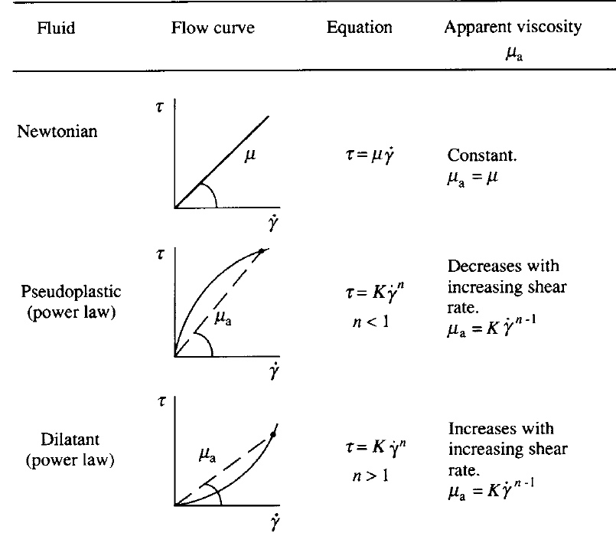

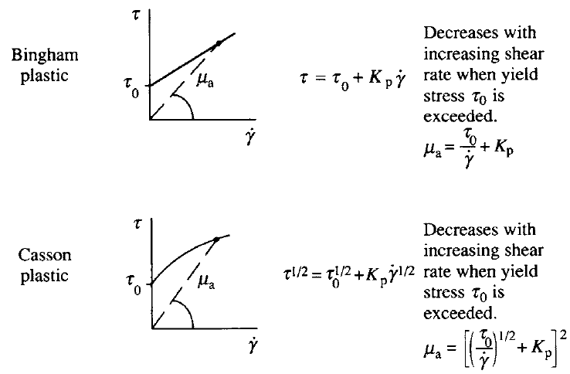
are flow curves for plastic flow
these Flow curves are for Plastic flow

Slide 29
Newtonian fluids, example water.
A classic example of a Pseudoplastic fluid is ketchup. It flows slowly when undisturbed but becomes much thinner and easier to pour when shaken or squeezed—this is called shear-thinning behavior. Other great examples include toothpaste, blood, and certain paints, all of which become less viscous under stress or motion.
Dilatant fluids get thicker when you apply force—like they resist sudden movement.
Wet sand: When you step on it, it firms up under pressure. Silly Putty or slime: Acts more solid when pulled quickly. Certain industrial suspensions: Like ceramic slurries or dense polymer mixtures.
A great example of a Bingham plastic is toothpaste. It behaves like a solid until you apply enough pressure—then it flows smoothly out of the tube as a thick paste.
examples include Payasam (shear thickening ) mayonnaise, drilling mud, and cosmetic creams, all of which need a certain stress to start flowing.
Casson plastic fluids minimum stress to start flowing, and then behave like a shear-thinning fluid.
Blood: Classic Casson fluid—needs a threshold stress to flow due to red cell interactions.
Chocolate: Especially molten chocolate in manufacturing—thick until stirred or pumped.
Printing inks: Flow only when pressure is applied, ideal for controlled spreading.
Cosmetic creams: Like foundation or thick lotions—flow starts only after a certain force.

Slide 30
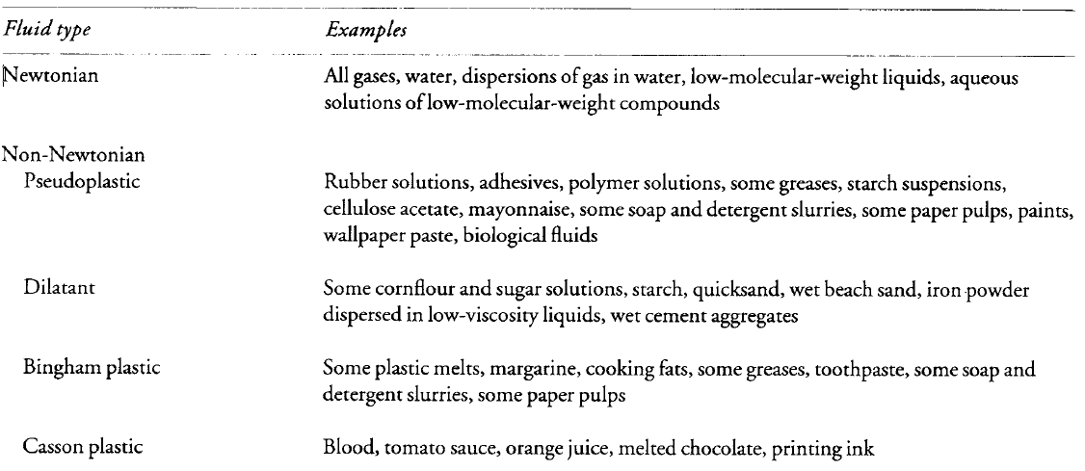

Slide 31
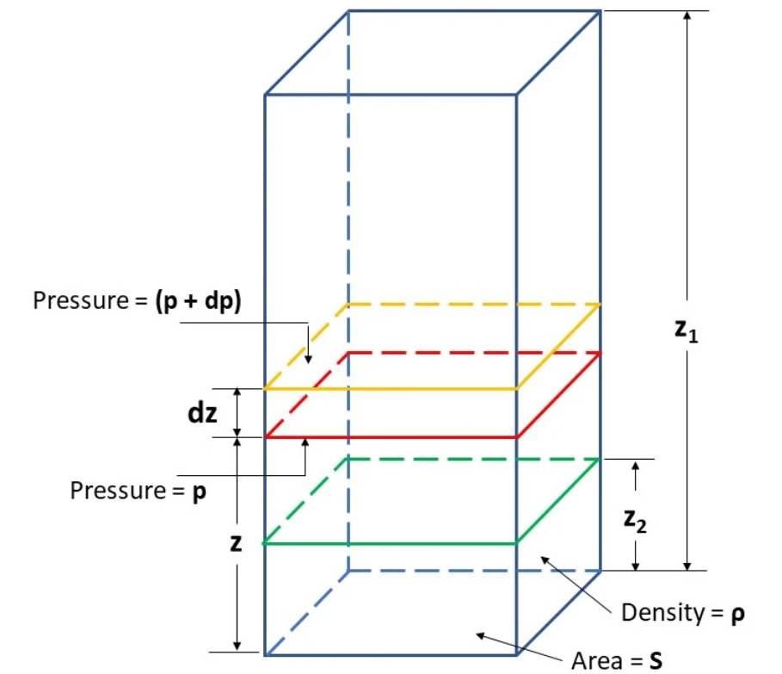
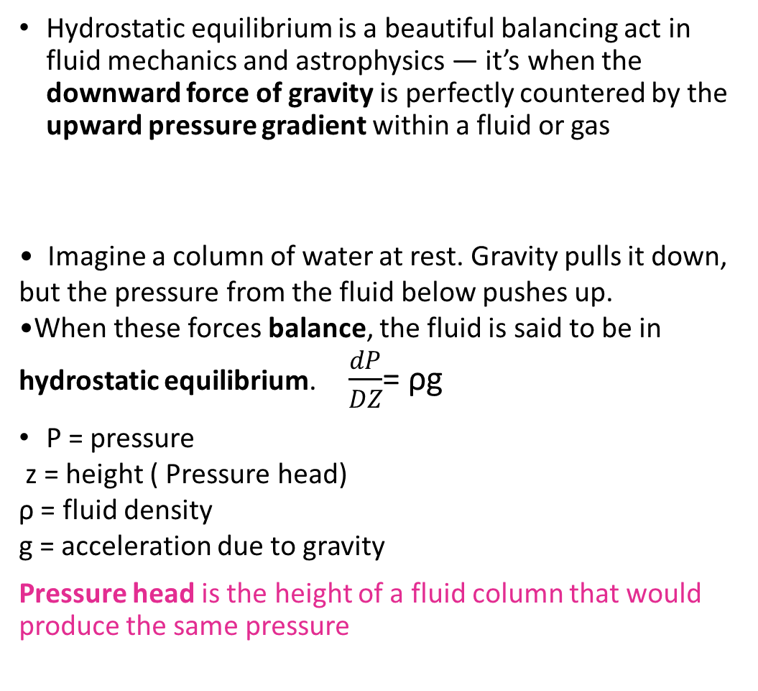
Hydrostatic equilibrium
Hydrostatic equilibrium is a beautiful balancing act in fluid mechanics and astrophysics — it’s when the downward force of gravity is perfectly countered by the upward pressure gradient within a fluid or gas
Imagine a column of water at rest. Gravity pulls it down, but the pressure from the fluid below pushes up.
When these forces balance, the fluid is said to be in hydrostatic equilibrium. $\frac{dP}{DZ}$= ρg
P = pressure
z = height ( Pressure head)
ρ = fluid density
g = acceleration due to gravity
Pressure head is the height of a fluid column that would produce the same pressure
P = ρgh

Slide 32

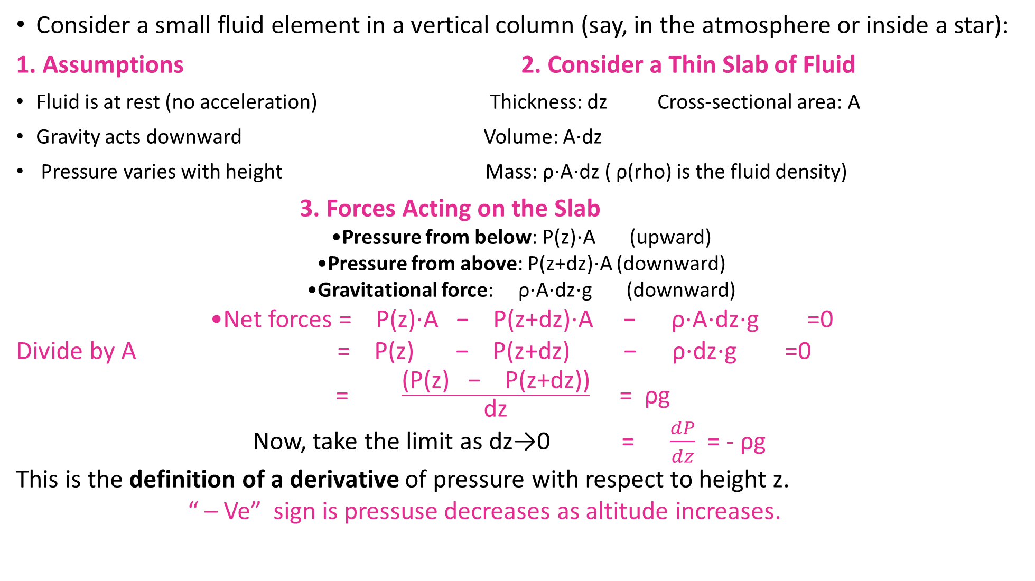
Derivation of pressure head
Consider a small fluid element in a vertical column (say, in the atmosphere or inside a star):
1. Assumptions 2. Consider a Thin Slab of Fluid
Fluid is at rest (no acceleration) Thickness: dz Cross-sectional area: A
Gravity acts downward Volume: A⋅dz
Pressure varies with height Mass: ρ⋅A⋅dz ( ρ(rho) is the fluid density)
3. Forces Acting on the Slab
Pressure from below: P(z)⋅A (upward)
Pressure from above: P(z+dz)⋅A (downward)
Gravitational force: ρ⋅A⋅dz⋅g (downward)
Net forces = P(z)⋅A − P(z+dz)⋅A − ρ⋅A⋅dz⋅g =0
Divide by A = P(z) − P(z+dz) − ρ⋅dz⋅g =0
= $\frac{\text{(}\text{P}\text{(}\text{z}\text{)} \text{−} \text{P}\text{(}\text{z}\text{+}\text{dz}\text{)}\text{)}}{\text{dz}}$ = ρg
Now, take the limit as dz→0 = $\frac{dP}{dz}$ = - ρg
This is the definition of a derivative of pressure with respect to height z.
“ – Ve” sign is pressuse decreases as altitude increases.

Slide 33
Hydrostatic equilibrium Applications
Applications—from the depths of oceans to the hearts of stars.
Here’s how it shows up in real life:
Civil engineering: Used in designing dams, water tanks, and hydraulic systems to ensure structural stability under fluid pressure
Atmospheric science: Explains how pressure decreases with altitude,
helping meteorologists predict weather patterns.
Oceanography: Helps model pressure variations with depth,
crucial for submarine design and marine studies.
Star formation: Stars like our Sun maintain their shape by balancing inward gravity with outward pressure from nuclear fusion.
Planetary shapes: Determines whether celestial bodies are spherical—
key to classifying planets vs. dwarf planets.
Stellar evolution: Predicts how stars change over time based on shifts in internal pressure and gravity

Slide 34

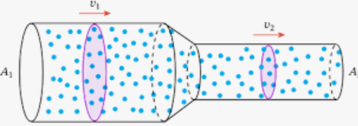
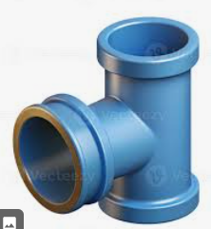
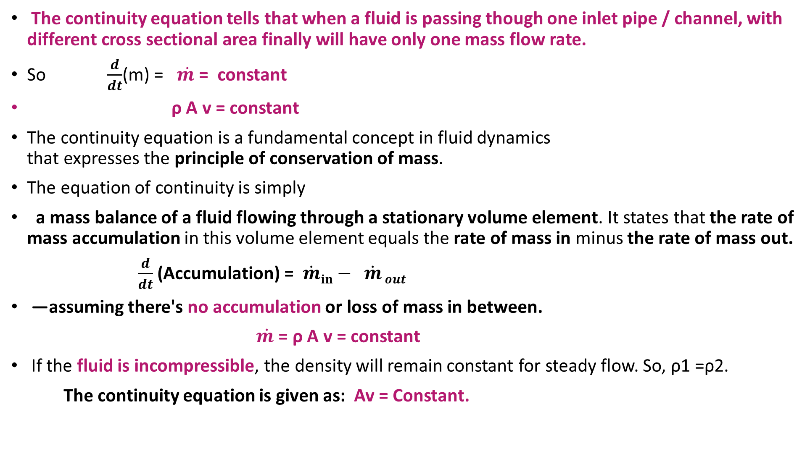
The continuity equation
The continuity equation tells that when a fluid is passing though one inlet pipe / channel, with different cross sectional area finally will have only one mass flow rate.
So $\frac{d}{dt}$(m) = $\dot{m }$= constant
ρ A v = constant
The continuity equation is a fundamental concept in fluid dynamics that expresses the principle of conservation of mass.
The equation of continuity is simply
a mass balance of a fluid flowing through a stationary volume element. It states that the rate of mass accumulation in this volume element equals the rate of mass in minus the rate of mass out.
$\frac{d}{dt}$ (Accumulation) = $\dot{m}in−$ $\dot{m}$ $out$
—assuming there's no accumulation or loss of mass in between.
$\dot{m }$= ρ A v = constant
If the fluid is incompressible, the density will remain constant for steady flow. So, ρ1 =ρ2.
The continuity equation is given as: Av = Constant.

Slide 35
Newton’s laws of motion
Newton’s First Law of Motion—also known as the Law of Inertia—is all about how objects behave when force is acting on them.
An object at rest stays at rest, and then set into motion continues in uniform motion, only when an external force is applied. F= m a
Where f = force ; m= mass ; a =acceleration.
“If nothing messes with me, I’m sticking to what I’m doing.”
An object at rest stays at rest, and an object in motion stays in motion with the same speed and direction unless acted upon by an external force.
Newton's second law of motion states that “Force is equal to the rate of change of momentum. For a constant mass, force equals mass times acceleration.
Force = mass x acceleration
Acceleration as rate of change of velocity with respect to time = dv/ dt
Force = m(dv/ dt)
= d(mv) dt rate of change of momentum.

Slide 36
Bernoulli's Principle
Bernoulli’s equation is based on the law of conservation of energy. It says:
In a steady, ideal flow of an incompressible fluid (no friction, no heat loss), the total mechanical energy at any two points along a streamline remains constant.
Why Bernoulli’s equation assumes constant energy ?
“Energy can’t be created or destroyed but only changed from one form to another” Law of conservation of energy thermodynamic first law.
“It’s derived under ideal conditions—steady flow, incompressible fluid, and no energy loss— so total mechanical energy remains conserved along a streamline.”
A fluid in motion typically has three main types of mechanical energy
Kinetic, Potential , Pressure Energies.
Bernoulli's principle relates the pressure of a fluid to its speed.
Applications one can determine how much fluid flows through a pipe. It enables us to quantify the change in velocity and pressure experienced by a fluid flowing from one pipe with one cross-sectional area to another with another cross-sectional area.

Slide 37
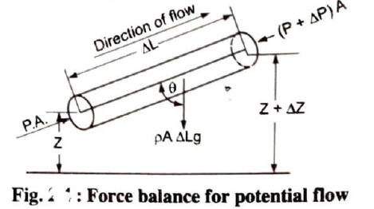
Assumptions for bernoulli’s i) The fluid is ideal, i.e., Viscosity is zero.
(ii)The flow is steady
(iii) The flow is incompressible.
(iv)The flow is irrotational.

Slide 38
Bernoulli’s theorem for steady flow of an incompressible fluid.
Let us consider an element of length ∆L of stream tube of constant cross section area
Assume that the cross sectional area of element be A and the density of the fluid be ρ
Let U and P be the velocity and pressure at the entrance (upstream ) and
(U+ ∆U) and (P+ ∆P ) are the corresponding quantities at the exit (downstream)
The force acting on the element treating the element as a free body or
1.The force from the upstream pressure = P x A ( force acting in the direction of flow taken as positive) 2.The force from downstream pressure normal to the cross section of the tube = (P+ ∆P )A (that is the force opposing the flow taken as negative )
3. The force from the weight of a fluid that is the force of gravity acting downwards taken as negative = weight = mass x acceleration due to gravity = ρ A ∆L g
The components of this force acting opposed to the direction of flow = ρ A ∆L g cosɵ
Of the three forces cited above the first one helps the flow with
the remaining two forces oppose the flow.

Slide 39
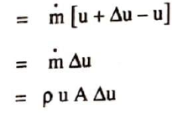
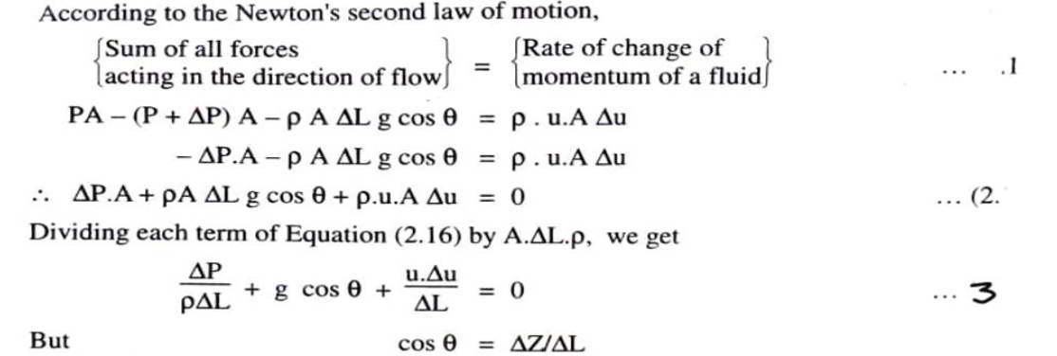
Rate of change of momentum of a fluid along the fluid element =

Slide 40
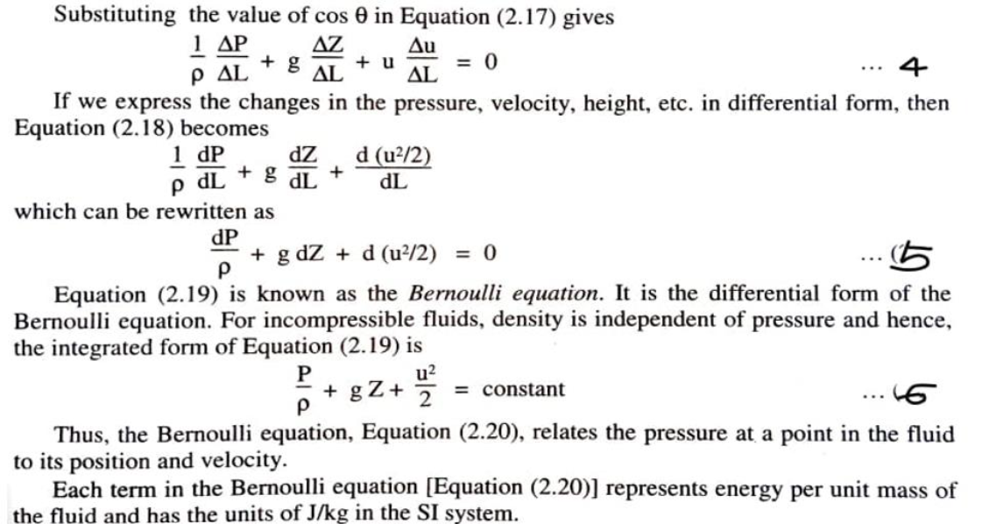



$$=$$

Slide 41
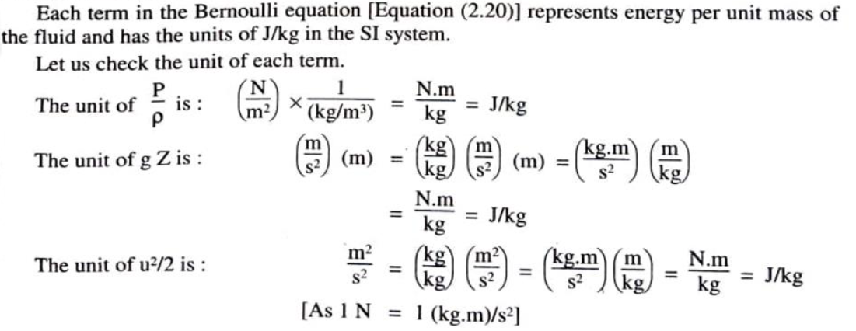

Slide 42

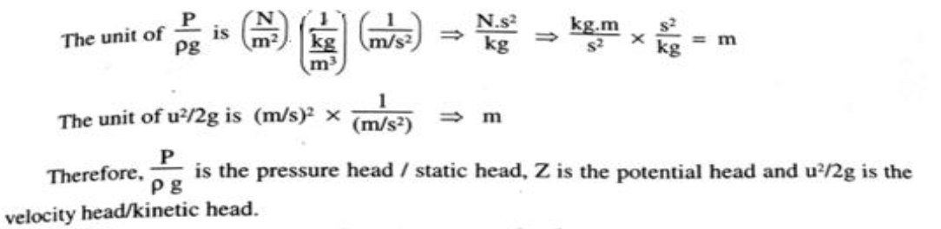
On dividing above equation with “g” through out
Then equation 6 becomes P/ ρg + Z + u² / 2g = Constant --------- eq (7 )
Each term in this equation represents energy per unit weight of fluid and has the dimensions of length. Hence each term is regarded as the head that is contributing to total fluid head.

Slide 43
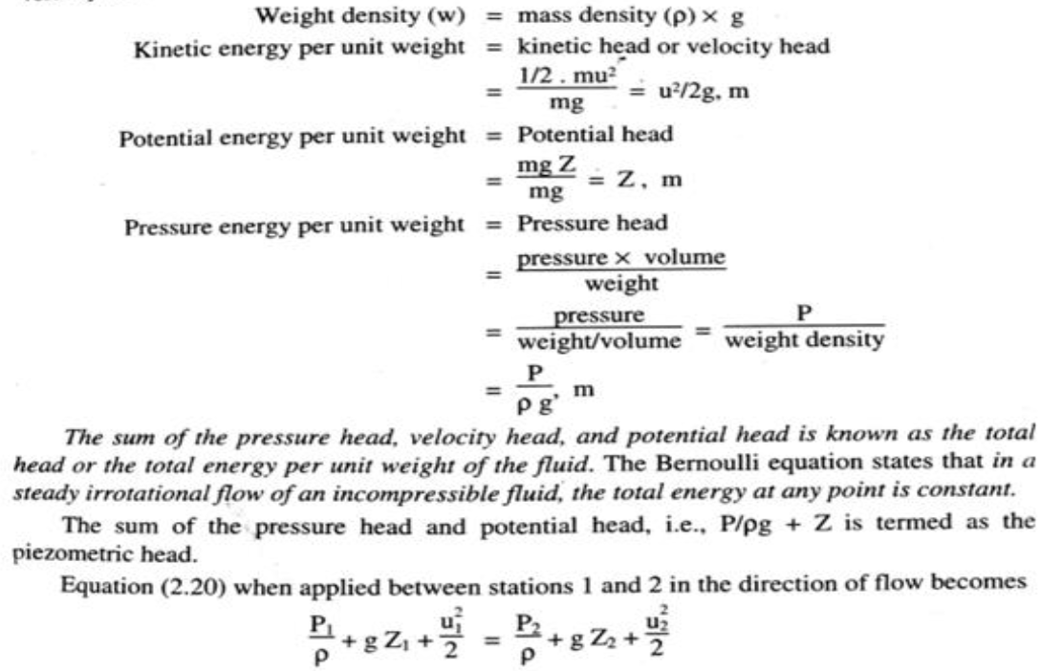

Slide 44
Bernoulli’s theorem for steady flow of an incompressible fluid.
It states that the total energy at any point of the fluid is constant for a steady, ideal flow of an incompressible fluid, The total energy consists of kinetic, potential, and pressure energy.
Pressure energy it is the work which must be done in order to introduce a fluid into a system without changing the volume it is the energy of fluid due to pressure acting on it.
Pressure energy (flow energy) = force x displacement = work done on a fluid
= ( force x displacement ) x [area / area]
= Pressure x volume( Since Pressure = force/ area; volume = displacement x area )
pressure energy per unit mass of a fluid = ( Pressure x volume ) / mass
= pressure / density
pressure energy per unit mass of a fluid = P / ρ , units: J/Kg in S.I system.
Kinetic energy it is the energy of fluid by virtue of its motion with reference to some arbitrary fixed body.
The kinetic energy of a fluid of mass M moving with velocity U is given by
kinetic energy = ½ (mu²)
kinetic energy per unit mass of fluid = ½ u² , units: J/Kg in S.I system

Slide 45
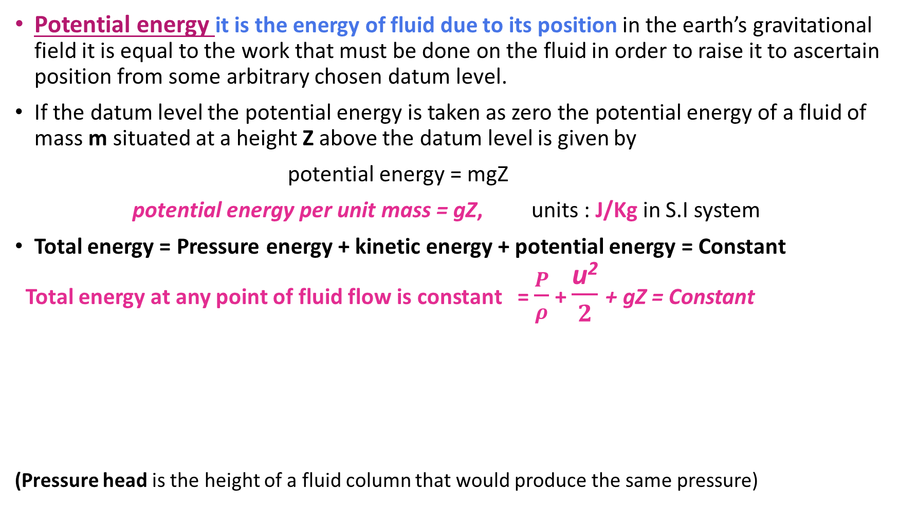
Potential energy it is the energy of fluid due to its position in the earth’s gravitational field it is equal to the work that must be done on the fluid in order to raise it to ascertain position from some arbitrary chosen datum level.
If the datum level the potential energy is taken as zero the potential energy of a fluid of mass m situated at a height Z above the datum level is given by
potential energy = mgZ
potential energy per unit mass = gZ, units : J/Kg in S.I system
Total energy = Pressure energy + kinetic energy + potential energy = Constant
Total energy at any point of fluid flow is constant = $\frac{P}{ρ}$ + $\frac{\text{u}\text{2}}{2}$+ gZ = Constant
(Pressure head is the height of a fluid column that would produce the same pressure)
Type of Energy | Symbol | What It Represents
Pressure Energy | P | Energy due to the fluid’s pressure
Kinetic Energy | (1/2)ρv² | Energy due to the fluid’s velocity (motion)
Potential Energy | ρgh | Energy due to height above a reference level

